Slide 1

Predictive Modelling Conclusion
By : Shreyash Dhomkar

Slide 2
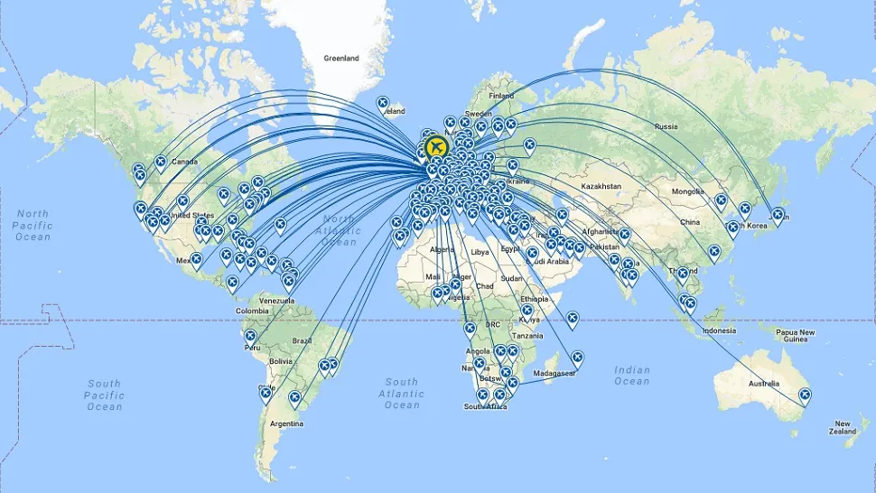
British Airways Global Reach
British Airways serves passengers traveling to 103 countries worldwide. Passengers have booked flights to various destinations, including popular tourist destinations like New Zealand, India, and the United Kingdom, as well as business hubs like China, Singapore, and the United States. Notably, some countries like Myanmar (Burma) and Svalbard & Jan Mayen represent more remote or less frequently traveled destinations. The airline's extensive network covers diverse regions, catering to both leisure and business travelers across the globe.

Slide 3
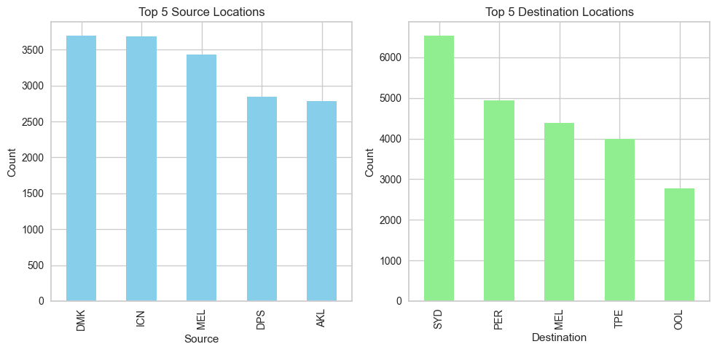
British Airways Global Network Insights
among the top 5 source locations, DMK (Don Mueang International Airport, Bangkok) and ICN (Incheon International Airport, Seoul) are the most frequent, closely followed by MEL (Melbourne Airport) and DPS (Ngurah Rai International Airport, Bali).
among the top 5 destination locations, SYD (Sydney Airport) is the most common, indicating a high volume of flights to Sydney, followed by PER (Perth Airport) and MEL (Melbourne Airport), reflecting significant travel demand to these cities.

Slide 4
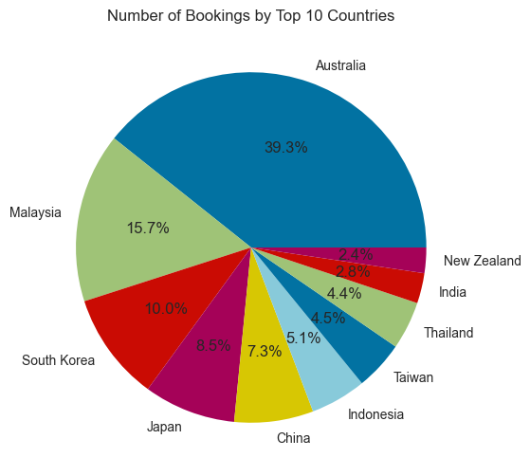
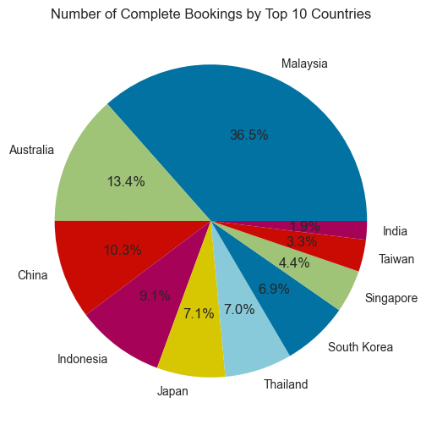
Booking Distribution Overview
The data indicates that among the top 10 countries with complete bookings, Malaysia has the highest share at 36.5%, followed by Australia (13.4%) and China (10.3%). The remaining countries contribute varying percentages to the total number of complete bookings.
Distribution of Top 10 Countries by Booking Count.
Among the top 10 countries by booking count, Australia has the highest share with 39.3%, followed by Malaysia (15.7%), and South Korea (10%). Japan and China also represent significant portions with 8.5% and 7.3% respectively, while the remaining countries contribute smaller percentages to the total bookings.
Complete Booking Distribution Among Top 10 Countries

Slide 5
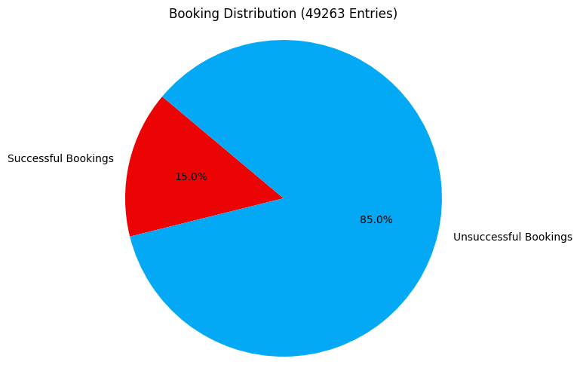
Booking Status Overview
total booking entries
49263
completed bookings
7389
There are a total of 49,263 booking entries in the system.
This figure encompasses all bookings recorded in the database.
In total, 7389 bookings have been successfully completed across all entries, representing 15% of the total completed bookings
uncompleted bookings
41874
In total, 41,874 bookings remain uncompleted across all entries, constituting 85% of the total completed bookings
Out of 49263 booking entries only 15 % bookings completed.

Slide 6
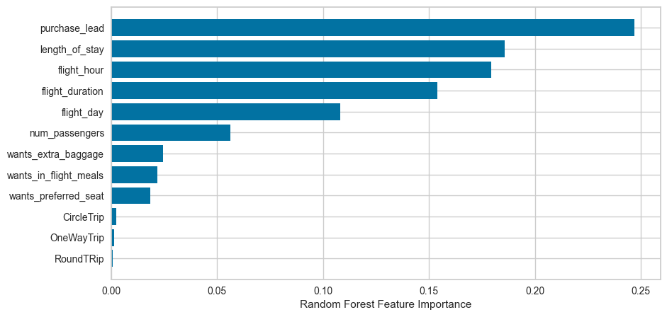
Predictive modelling results
Recall Rate
63%
Precision
62%
Chance of predicting true successful bookings.
Will be predicted as actually completed bookings out of all successfully completed bookings.
63% Chance of predicting true incomplete bookings correctly.
Accuracy of the model predicting successful or incomplete booking is
Accuracy
62%
We are concerned with not predicting the successful bookings correctly. Imbalance dataset drives higher accuracy but it does not accurately predict the successful bookings. Dataset was balanced with 7k labelled as incomplete bookings and 7k as complete bookings.
Top features that can drive successful flight bookings.

